Slide 1
The Eagle Scout Leadership Service Project
&
Trail to Eagle

Slide 2
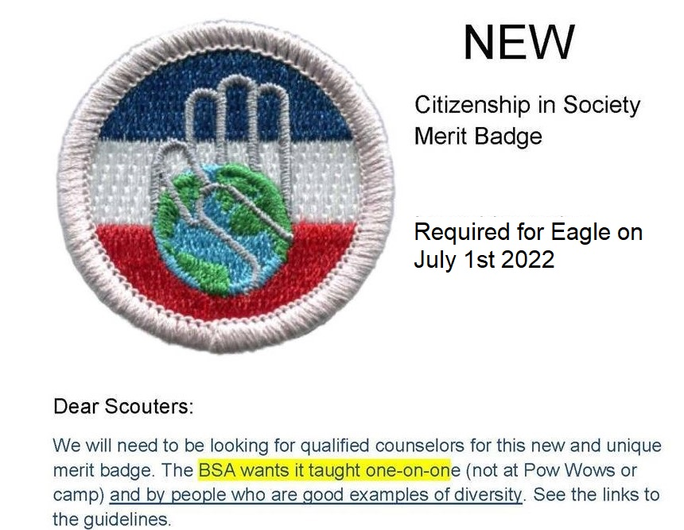
GRAND TETON COUNCIL

Slide 3
Definitions
Grand Teton Council:
Serves Scouting Districts and Units in East Idaho and Western Wyoming.

Slide 4
Definitions
District Advancement Committee Member
District approval of Eagle Projects
Sits on Eagle Boards of Review representing the District
May be called Eagle Scout Coaches

Slide 5
The Eagle Scout Leadership Service Project
&
Trail to Eagle

Slide 6
Overview
Help Leaders, Scouts, and Parents understand the Eagle Project and the Trail to Eagle.
Help your Scouts plan an Eagle Leadership Project that gets approved the first time.
What are the requirements?

Slide 7
Life Board of Review
At each Scout’s Life Board of Review, the Unit Advancement Chairman should give the new Life Scout an “Eagle Scout Leadership Service Project Workbook” and an “Eagle Scout Rank Application”.
He should be coached on the Trail to Eagle as presented here. The Advancement Chairman should follow up with the new Life Scout frequently.

Slide 8
Purpose of the Project
Note the full name – “Eagle Scout Leadership Service Project”
Demonstrate leadership of others
Learn about the planning process
The “product” of the project is secondary to the learning process for the Scout. Leading other youth is the main goal.

Slide 9
Requirements
“While a Life Scout, plan, develop, and give leadership to others in a service project helpful to your religious institution, school or your community.”

Slide 10
Definition - Plan and Develop
Note that a project where the Scout is given a “plan” or “detailed list” of the way the project must be done, by the organization to be served, does not qualify. The Scout must plan and develop the project – and show leadership.
The organization to be served probably does not know what constitutes a valid Eagle Scout Leadership Service Project. The Scout may need to educate them.

Slide 11
Give Leadership to Others
The Eagle candidate is to be the leader--to direct and manage the project. Yes… even the adults. Adults are take pictures, bring snacks, and only do work not allowed by youth.
Workers are to be youth – other Scouts & friends.

Slide 12
Limitations
“Routine labor..(or normal maintenance) should not be considered.” The project can not benefit BSA nor the council.
“The Project also may not be performed for a business or an individual, be of a commercial nature, or be a fund-raiser. (Fund-raising is permitted only for securing materials or supplies needed to carry out your project)”

Slide 13
Size
“There is no minimum number of hours that must be spent on carrying out the project. The amount of time spent must be sufficient for the Scout to clearly demonstrate leadership skills.” average is over 100.
“Significant Project” – much larger in scope than service done for Star & Life.

Slide 14
Originality
The project does not have to be original (something you dream up that has never been done before), but it certainly could be.
You may pick a project that has been done before, but you must accept responsibility for planning, directing, and following through to its successful completion.
It must be an individual project – two candidates cannot receive credit for working the same project.

Slide 15
Official BSA Guidance
Boy Scout Handbook
Eagle Scout Leadership Service Project Workbook (18-927D)
Advancement Committee Policies and Procedures (#33088)
Check the books or call your District Advancement Committee Member if you have questions.

Slide 16
Hints for Troops (Take it or leave it)
Assign an Eagle Project Advisor to work with all Eagle candidates:
Someone who is readily available to the Scouts
Preferably your Scout Committee Advancement Chairman
Knowledgeable in what is required -- and what is not.
Should establish a working relationship with District Advancement Committee – trust and understanding
This will help ensure consistency in expectations from Scout to Scout.
Don’t expect a Scout to please multiple adults, especially if the adults don’t fully understand the requirements. It is hard enough to please one.
Challenge the Scout to do his best, but accept what he is capable of doing. Be aware when learning has ceased and frustration sets in.
Leaders may not add or delete requirements for any rank (this applies to project).

Slide 17
Project Ideas
Landscaped school grounds
Collected coats for men’s shelter
Built shot-put pit for High School
Built bull-pens for High School baseball field
Repaired & cleaned out church storage shed
Built High School football drinking fountain & drain
Removed, sanded, painted 10 benches for City Library.
Repaired, re-roofed, and painted Cemetery Pump House
Built soft landing area under elementary school play toys.
Built newspaper re-cycling bins for Elementary School
Repaired church ball diamond – rototilled ground, planted grass.
Repaired Church shelter - painted, repaired & painted benches.
Painted hallway to football field & decorated with player numbers.
Two general categories:
Construction / repair
Service
The Internet has many sites with project ideas – use a search engine

Slide 18
Planning the Project
May start immediately after Life Board of Review (but not before)
Not necessary to have earned all 21 merit badges first. Please start AT LEAST 6 months before 18th birthday!
Meet with a certified Eagle Coach -- to verify that idea is acceptable -- before doing much detailed planning or writing. They must approve your project before you can begin. See list on Website under Eagle Scout Information
Choose project you’ll enjoy
Meet with the benefiting organization -- discuss their needs, expectations, and possible financial help.
Must use Eagle Scout Leadership Service Project Workbook, to submit project plan for approval. Download from www.tetonscouts.org.

Slide 19
The Ideal Plan - Your Goal
The written project plan should have enough detail that another Scout could take the proposal, as submitted, and successfully carry out your desired plan – in your absence.
The project could be worked on an island and everything needed to do the work would be there – because it is listed in the plan.
Reach for the goal, but accept reality.

Slide 20
Approvals Before Starting Work
The complete detail plan (Workbook) must be approved by the following before the project is started (preferably in this order):
Benefiting Organization Representative,
Unit Leader (Scoutmaster, Coach, Advisor),
Unit Committee member (Advancement Chair),
District Advancement Committee Member.
Scout must have signatures from ALL of the above BEFORE starting work!

Slide 21
Working the Project
Perform the work as proposed in the approved Project Plan
Take a lot of pictures
Lead the team
Don’t do the work yourself
Don’t let adults lead your project (let them make lunch)
Keep records of:
Who worked (name, date, times)
Material, supplies, tools actually needed and used
All additional purchases
Problems encountered and how solved

Slide 22
Working the Project
“I advise them to count their travel time to and from meetings with individuals and the project site. If the Scout does not drive, he should count the driver’s time as well. It is recommended that the Scout keep a log or ledger of everyone he spends time talking to in person or on the phone, and all those who, in some way, have assisted in planning, developing and implementing his project. These are project helpers.” Mike Lo Vecchio BSA National Office

Slide 23
Final Written Report
How did it go?
What went as planned, what didn’t?
Who worked, when, and how long? What did they do? Total hours including planning?
Financial summary - report on fund raising & actual expenses. Compare to planned budget.
Include pictures - label them.
What did you learn about leading others?
What would you do differently next time?

Slide 24
Approvals After Completion
The final report is signed by:
The Eagle Candidate
Scoutmaster / Coach / Advisor
Representative of the benefiting organization
Any questions should be resolved before the Board of Review
Eagle Scout Board of Review is the final approval of Project.

Slide 25
Your Project is done What Next?
Fill out Eagle Scout Rank Application
Form 58-728
Print in Ink – Neatly or Type
Fill in all items down to and including Signature of Unit Committee Chair.

Slide 26
Eagle Scout Rank Application
Make sure you read and follow instructions! Here are a few tips.
Requirement 2 – Recommendations: Obtain a letter of recommend from each of these people – yes, including parents. Suggest Scout give each of these people an envelope addressed to Unit Advancement Chairman. Have them mail the letters or return the sealed envelope to parents, Scout, or Unit Advancement Chairman. Scouts are not to see the letters. Religious Leader should be Bishop, Pastor, or Priest.

Slide 27
Eagle Scout Rank Application
Requirement 3 - Merit Badges: List the dates earned – not the dates received.
Requirement 4 – Leadership Position: “While a Life Scout, serve actively for a period of six months in one or more of the following positions…” Check the list on Eagle Application Requirement #4 – do not list church positions.

Slide 28
Eagle Scout Rank Application
Requirement 6 – “Attach to this application a statement…” Don’t forget this step.
Signatures:
Applicant
Unit Leader
Unit Committee Chair

Slide 29
Trip to Scout Office
Give all paperwork to your Unit Advancement Chairman to take to the Scout Office: Eagle Project Workbook - Eagle Scout Rank Application - Statement of ambitions & life purpose, and Recommendation letters.
Scout Office will check application against BSA records. This will take from several hours up to 2-3 days. If there are any discrepancies, Unit Advancement Chairman or Leader will help Scout correct them.

Slide 30
Board of Review
Unit Advancement Chairman will set up and conduct a Board of Review. He/she will invite your District Advancement Committee Representative to attend.
The Board is made up of at least three and not more than six members.
Anyone 21 years old who understands Scouting may serve on the Board except Unit leaders and relatives.

Slide 31
Board of Review
The members of the board assemble 30 minutes before the candidate appears to review the application, reference letters, and service project workbook.
The Board may visit briefly with the parents.
The candidate’s unit leader introduces him to the members of the Board.
The unit leader may remain in the room, but does not participate in the board of review.

Slide 32
Board of Review
(He may be called on to clarify a point in question.)
After the Board of Review, the candidate and his leader leave the room while the board members discuss the acceptability of the candidate. The decision must be unanimous.
The candidate & parents are then informed of the Board’s decision.

Slide 33
Forms turned in to Scout Office
After the Board of Review, the Board Members sign the Eagle Scout Rank Application and fill out and sign an Advancement Report form.
The Unit Advancement Chairman will take the Eagle Project Workbook, Eagle Scout Rank Application, Letters of Recommend, Statement of ambitions, and Advancement Report form to the Scout Office to be submitted to National.

Slide 34
Eagle Court of Honor
Special ceremony to recognize only Eagle Scout(s)
Conducted only after National approval
~2-4 weeks after Board of Review
Planned and carried out by Troop and Parents
There is no required format -- tailor to please Scouts and parents.
Some items to consider:
Who to invite - up to the family
Date and time to accommodate schedule of special guests
Reserve church or other location
Reception decorations & refreshments - family responsibility
Letters from public officials - family’s choice
Photo album of Scouting career at reception

Slide 35
Questions
????

